Slide 1
XAI-Guided Interventional Retraining for Domain Adaptation
QIU Yaowen, yqiuau @ connect.ust.hk

Slide 2
Background & Objective
Problem: Models trained in one domain usually do not perform well in other domains.
Models pay attention on wrong objects, such as grassland (background) behind the cow (ground truth).
Domain Adaption Problem
Idea: (1) regular training (2) interventional retraining (IR)
Purpose : Reduce the impact of background
Expect: (1) Better Performance on Imagenetv2
(2) Better Performance on Validation set

Slide 3

Dataset - ImageNet
1000 Categories
1.28 M Training Images + 50,000 Validation Images

Slide 4
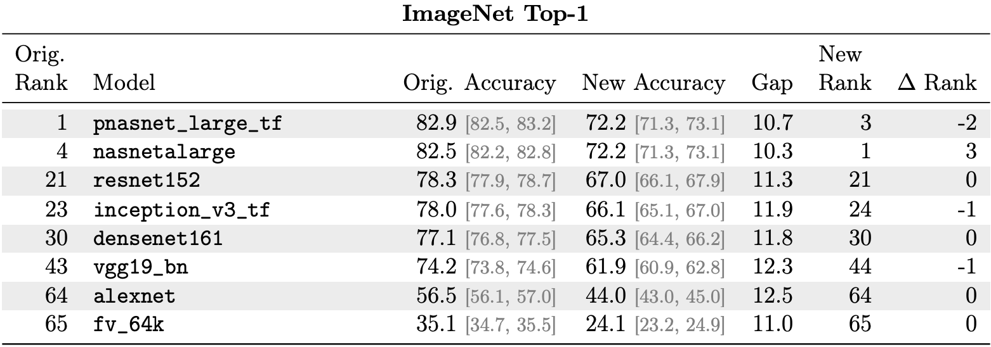
Dataset – ImageNetv2
10,000 Validation Images
Generated To measure the generation ability of the models
A huge drop of Top-1 Accuracy happens in all models

Slide 5
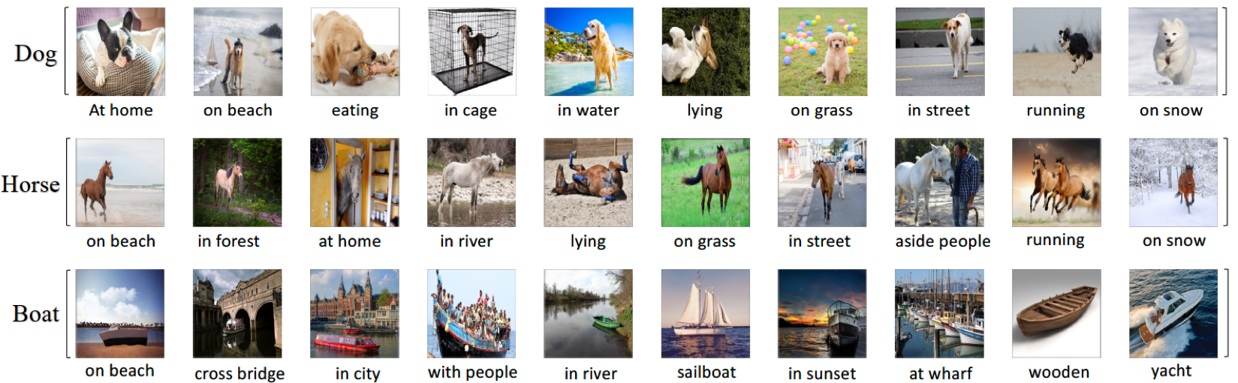
Dataset – NICO ?
Relatively Small Dataset -> Fast Experiments
Lack of Topic Tree
Can Perform similar experiments if time is enough

Slide 6
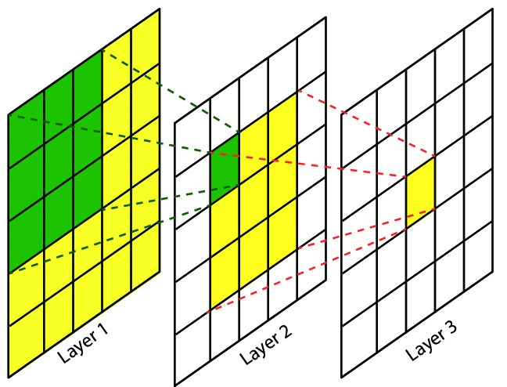
Framework
Trough Logit W
regular training phase
X_{i}
H_{i}
y_{i}
Image Example
Gradient
Gradient
Feature Mapping
Feature Map
Probability Vector
Trough Logit W’
X_{i}’
H_{i}’
y_{i}
interventional retraining phase
Image with object of interest only
Gradient
Fixed Feature Mapping
Modified Feature Map
Probability Vector

Slide 7
Baseline Model – ResNet50
Dataset | Top-1 Accuracy | Top-5 Accuracy
Validation Set | 75.97% | 92.82%
Imagenet-v2 | 63.41% | 84.67%

Slide 8
Methods
1. Label-dependent output explanation intervene training
2. Cluster-dependent output explanation intervene training

Slide 9
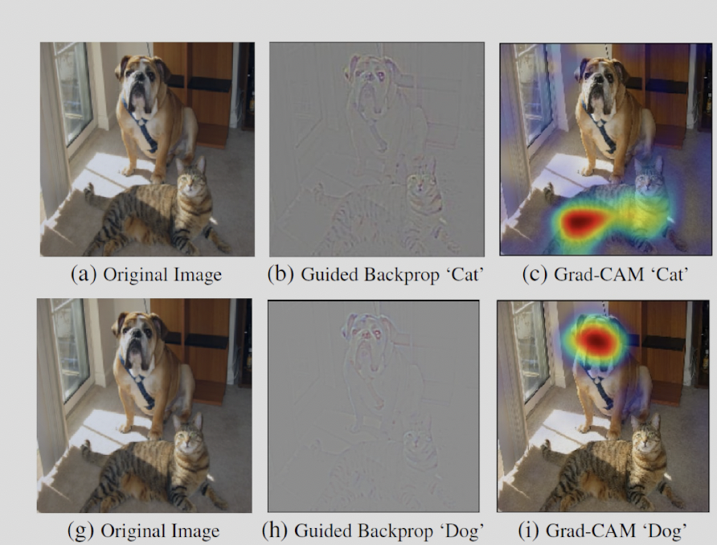
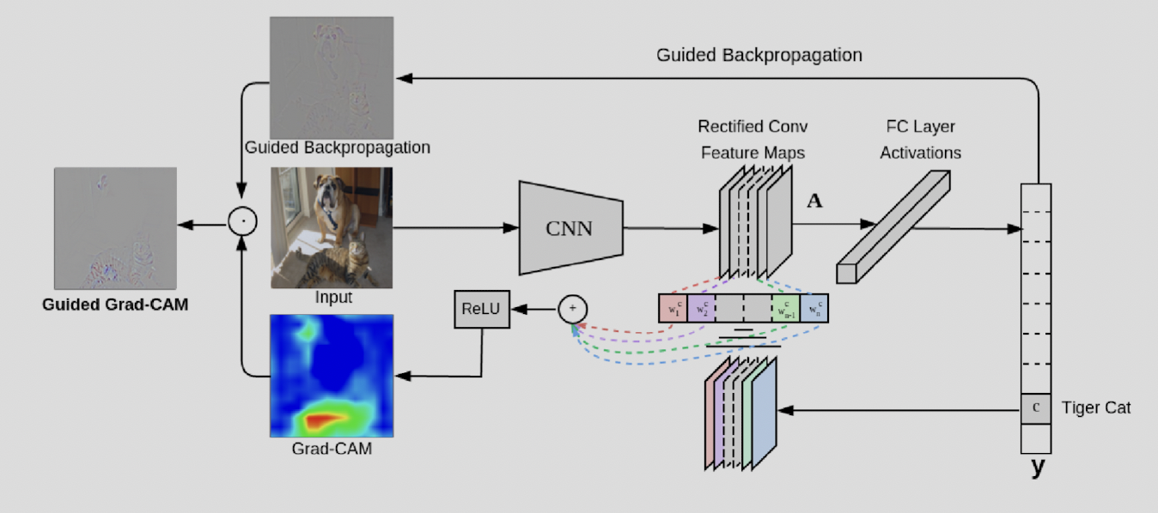
Interventional Retraining – Label-dependent output explanation
Gradient-weighted Class Activation Mapping(Grad-CAM):
Class discriminative
Localize True Label objects in the images

Slide 10
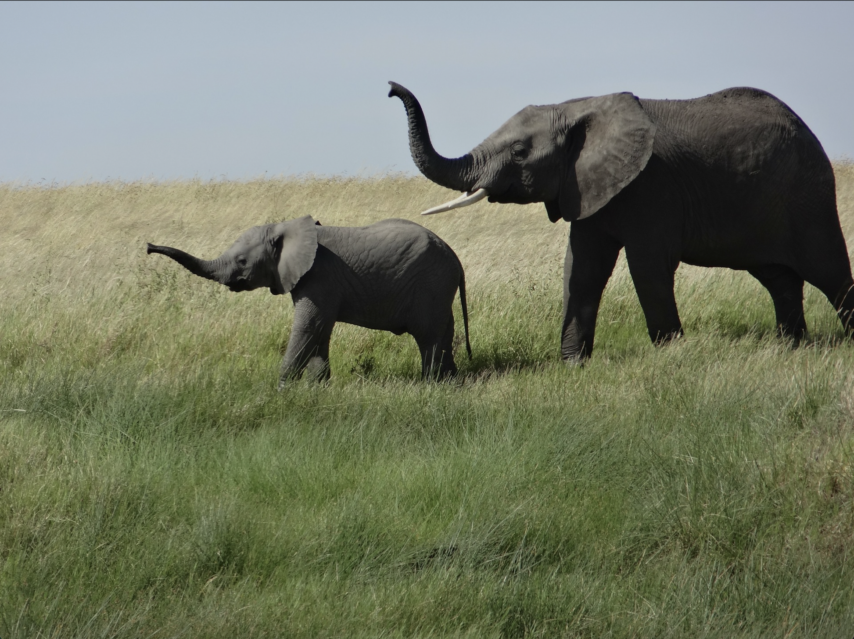
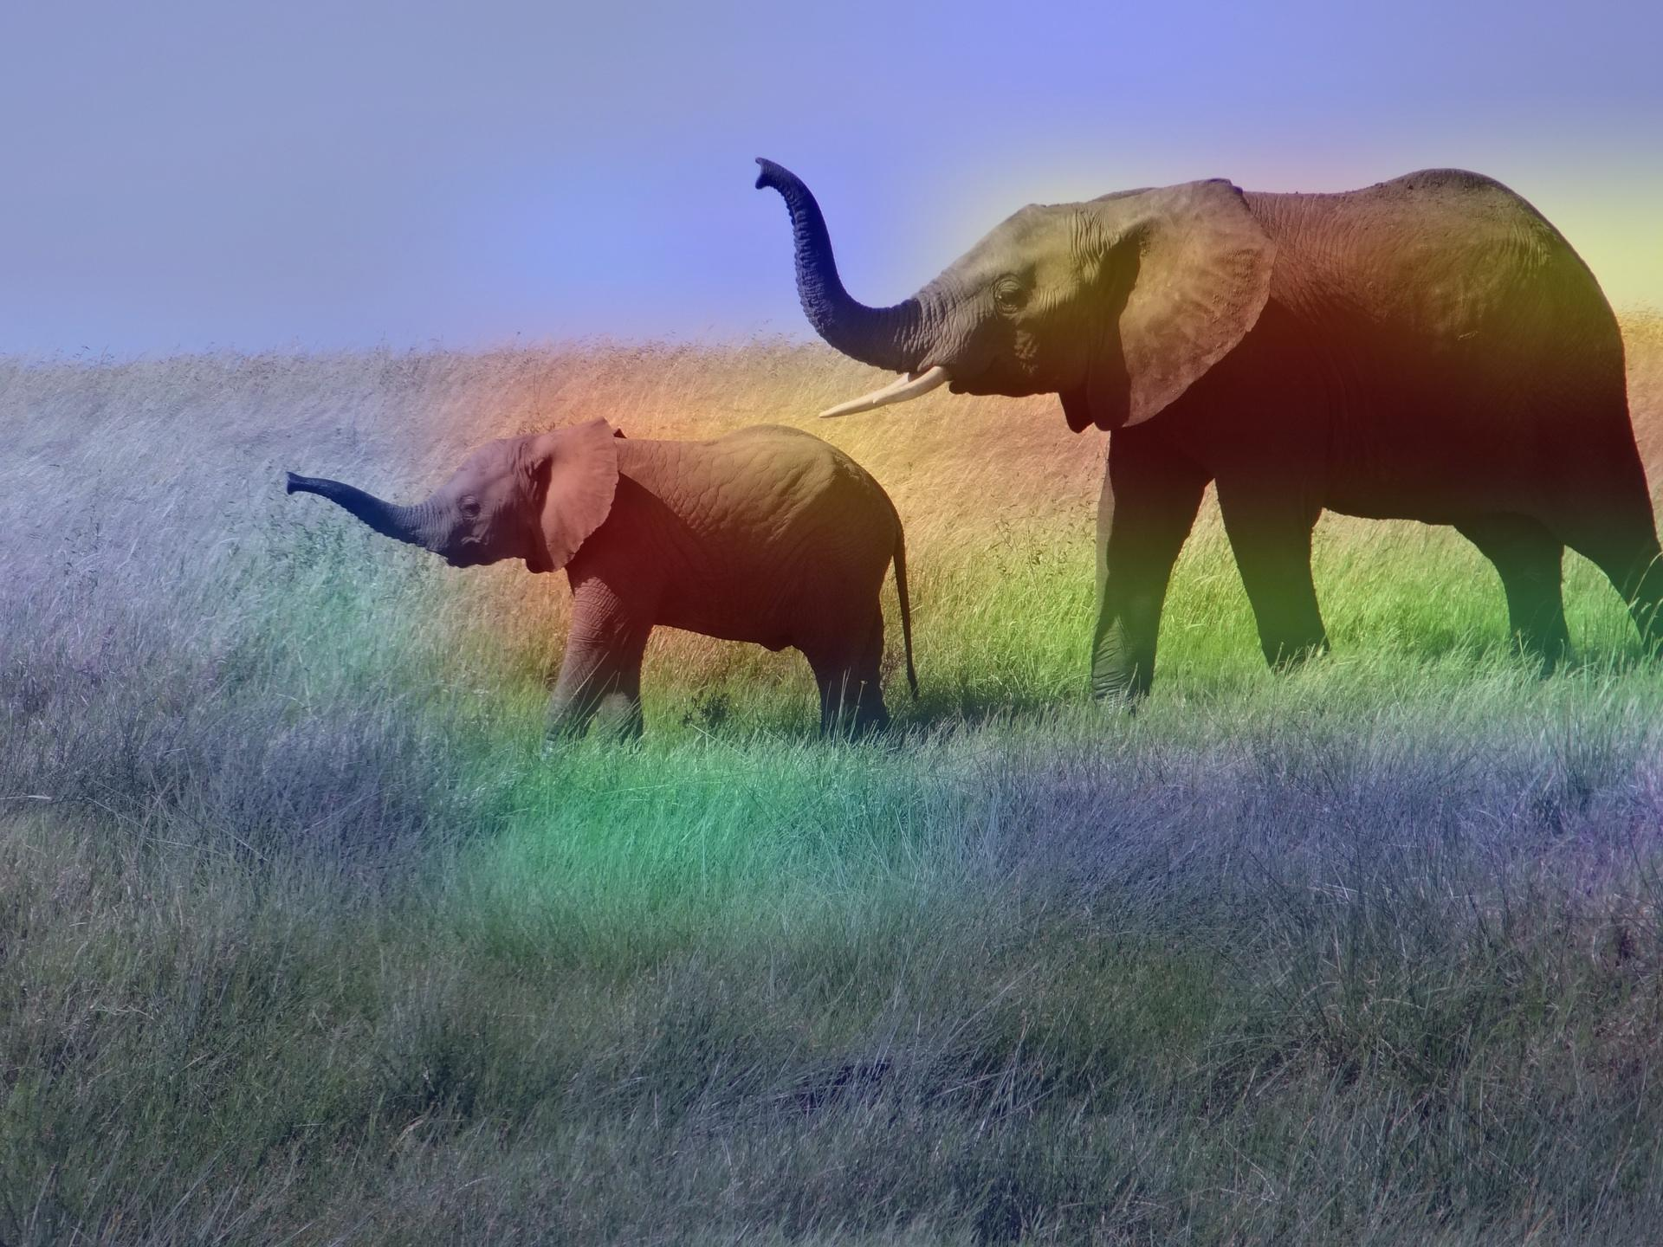
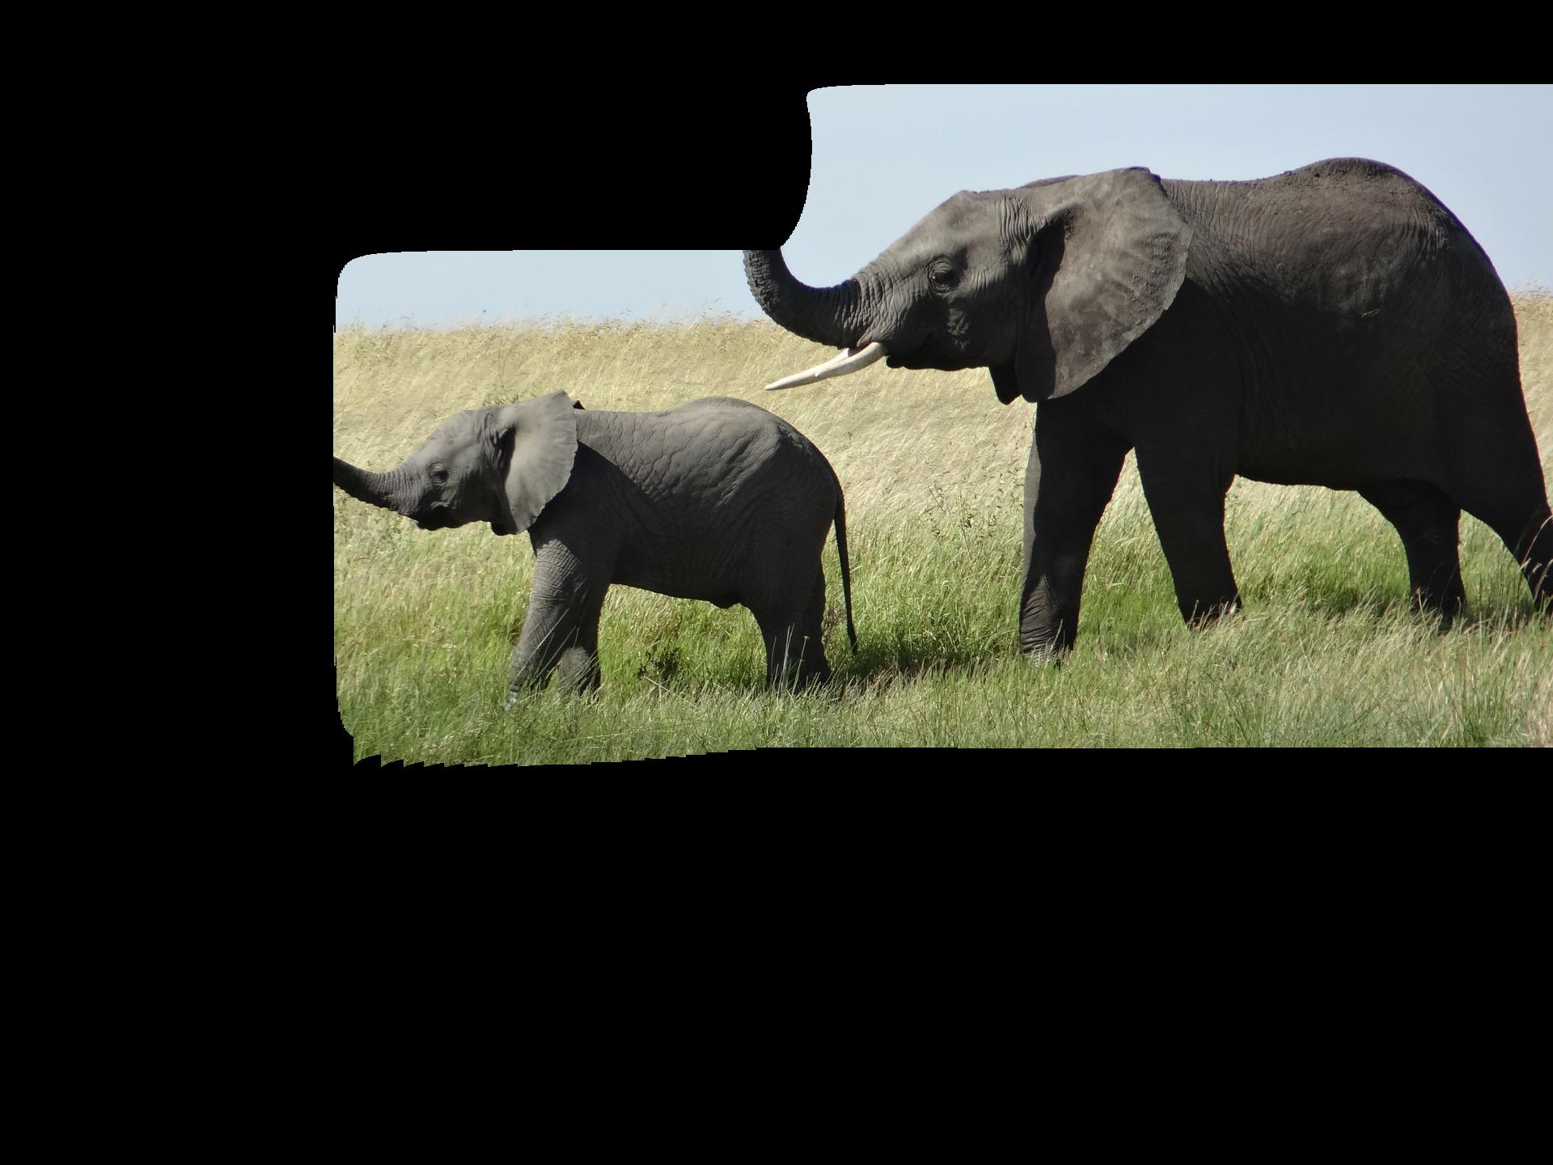
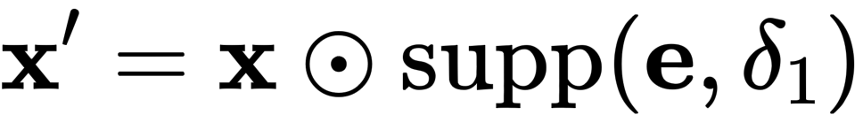
Interventional Retraining – Label-dependent output explanation
X : African Elephant
e : Grad-CAM
Remove the Background
δ1 = 0.01
Problem may occur: Extreme small prediction probability leads to unclear heatmap

Slide 11
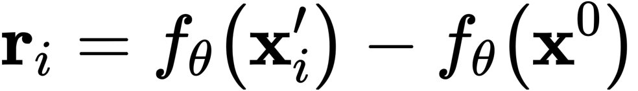
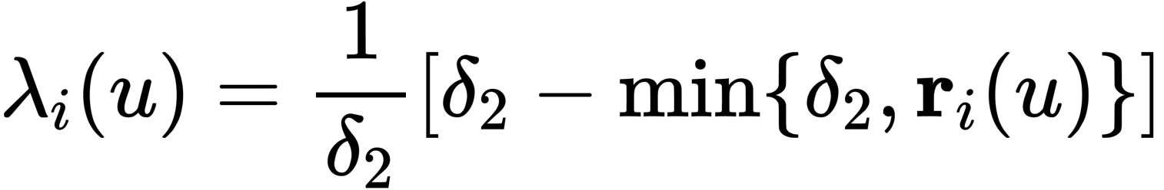
Interventional Retraining – Label-dependent output explanation
1. Perform Forward Propagation to get new feature map r.
2. Transform each unit in r through:
Physical Meaning: Substitute units with low value using randomization, while keep units with high value unchanged / approximate

Slide 12
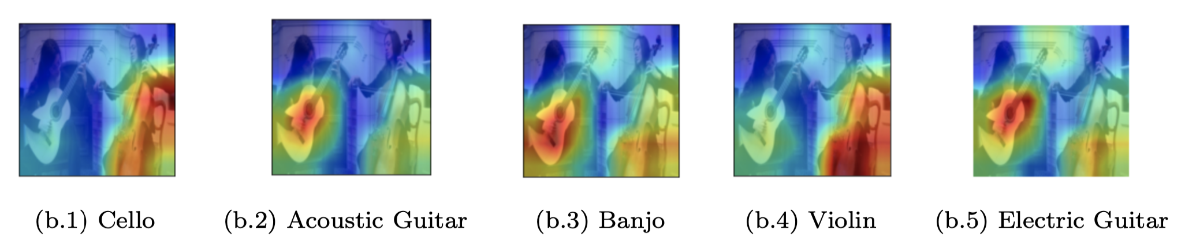
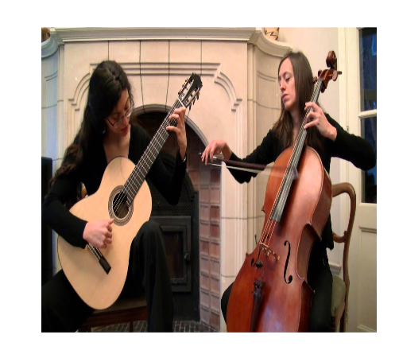
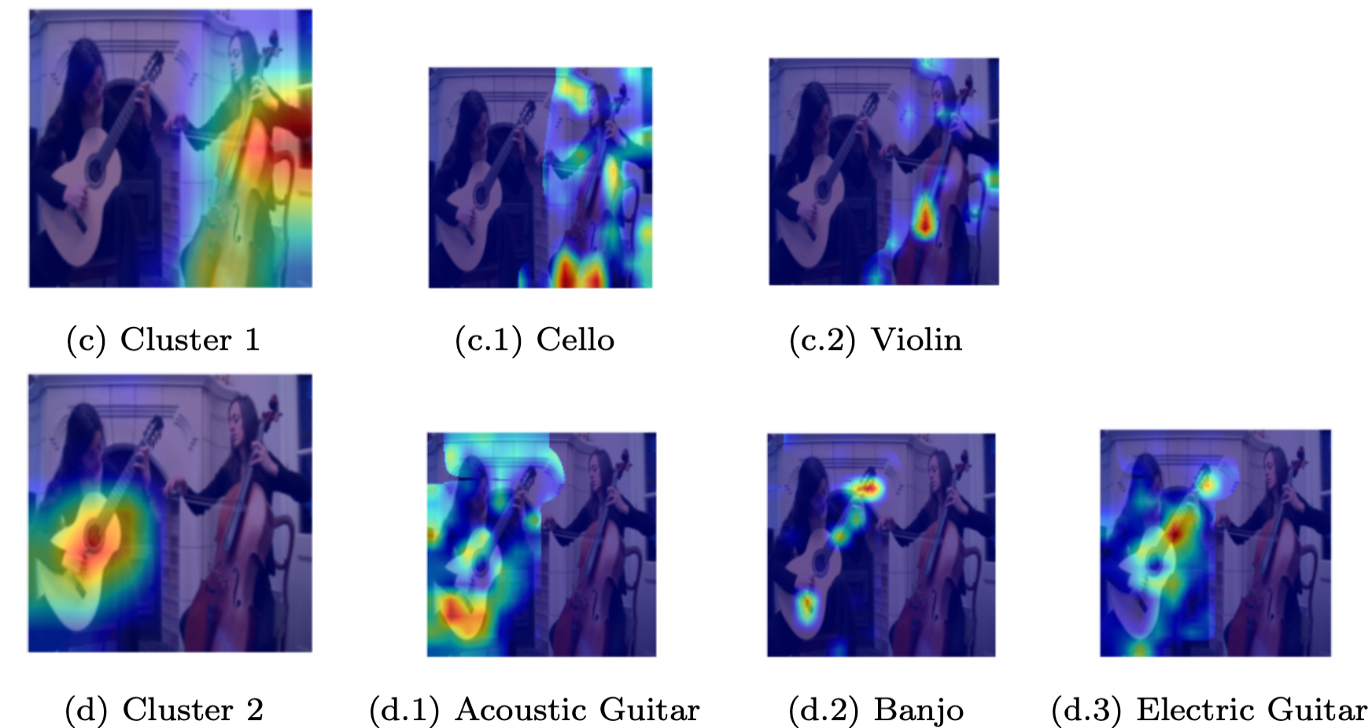
Interventional Retraining – Cluster-dependent output explanation
Top – 5 labels
Ground Truth : Cello
Problem may occur: True Label not exists in Top-5 prediction labels
Possible Solution: Increase k for such cases; if k reaches an upper bound, just ignore the example

Slide 13
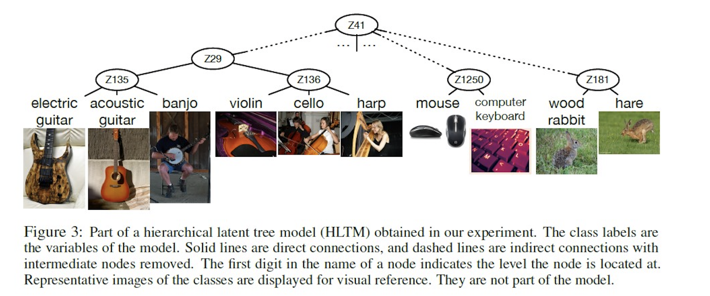
The Cluster is derived from a hierarchical latent tree model

Slide 14
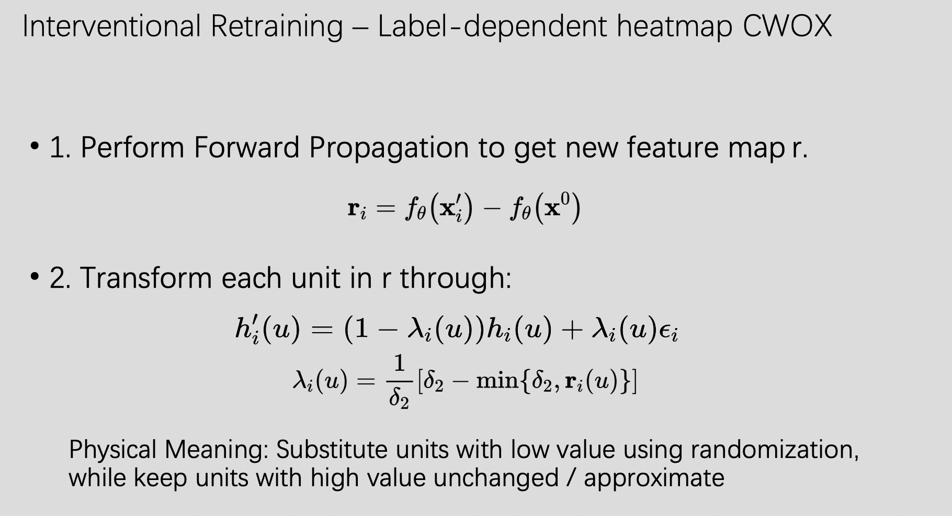
Interventional Retraining – Cluster-dependent output explanation
Perform Exactly the same as previous did

Slide 15
Training Settings
Parameters | Value
Learning Rate | 1e-4
Optimizer | Adam
Epochs | 20
Batch Size | 32
Delta1 | 0.01 (After normalize the heatmap)
Delta2 | 1 (Not sure the proper value, may change later)

Slide 16
Evaluation
1. Accuracy on Original Training Set
- Not sure about the result
2. Accuracy on Validation Set
- May increase or remains the same
3. Accuracy on Imagenet v2
- Expect to increase
4. Gap between Validation Set & Imagenet v2
- Expect to increase

Slide 17
Possible Works
Combine with Perplexity
High Perplexity often related to wrong attention & mix indistinguishable background and objects
The extent of intervene training should be different with easy examples
? Stronger Extent, Reason: model should learn more on difficult examples
? Weaker Extent, Reason: The quality of heatmap of such examples is bad, model may learn worse.

